Slide 1

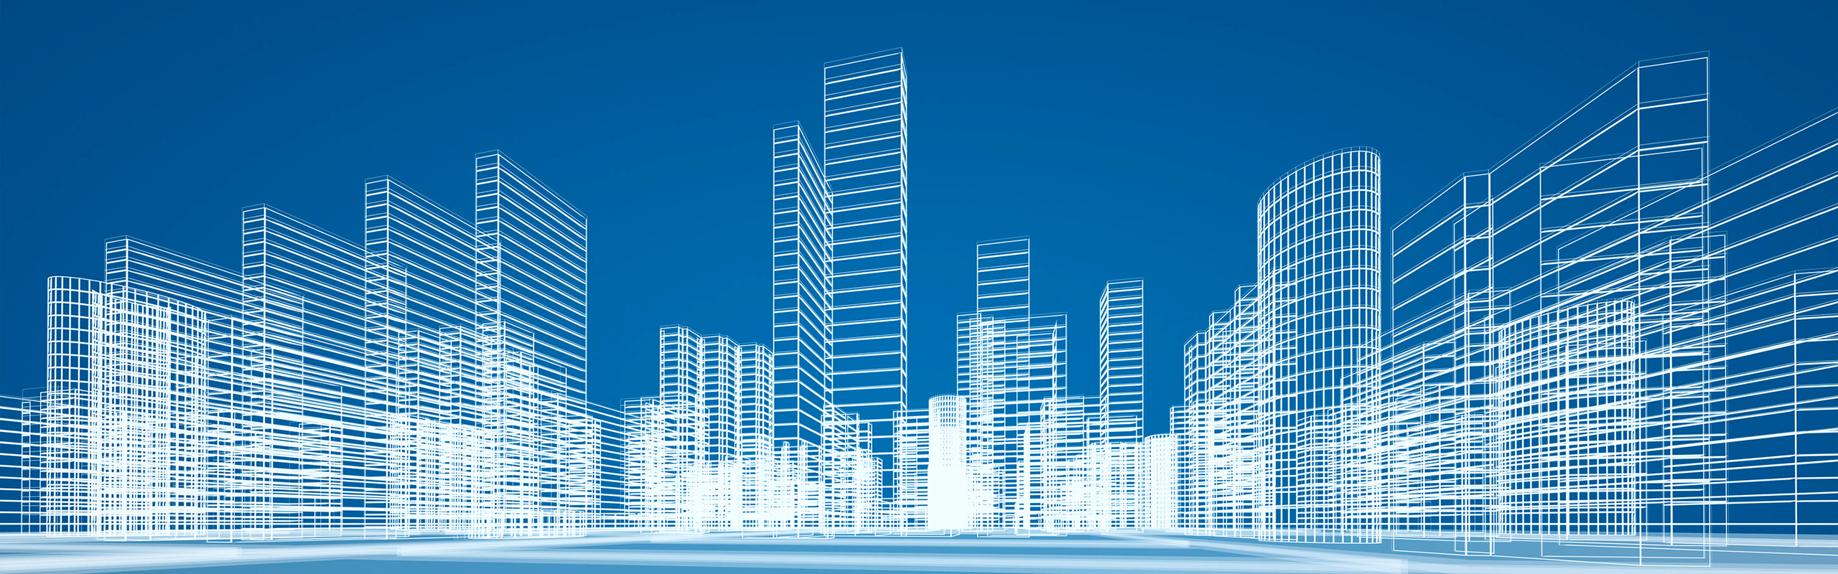
Blockchain Hackathon - Team 4
ProperT
a P2P tokenized smart property management system

Slide 2
Agenda
Problem Statement
Introduction to Team
Answers to the Questionnaire
Existing System
Proposed Solution
Platform Specifications
Business Applications, Post course
Demo
Q & A

Slide 3
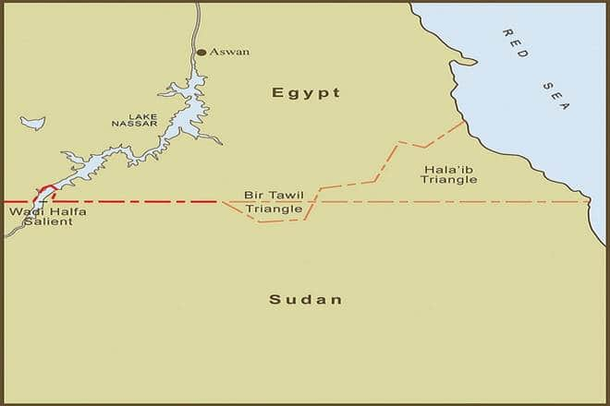

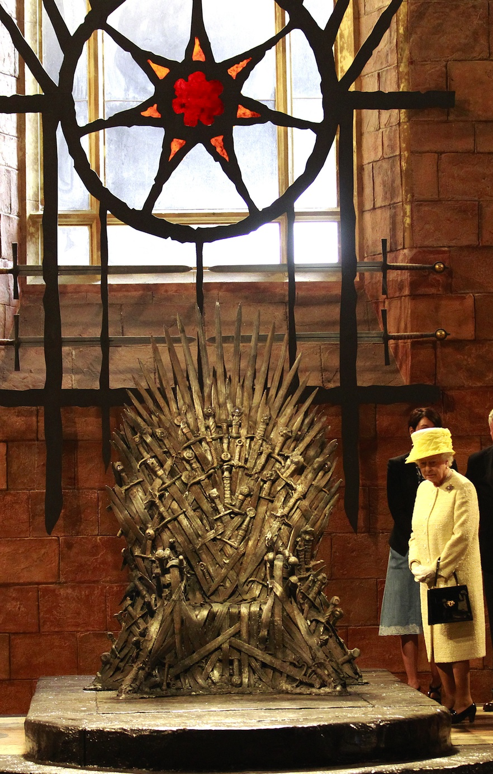
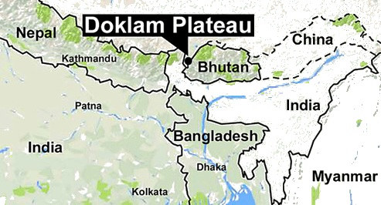
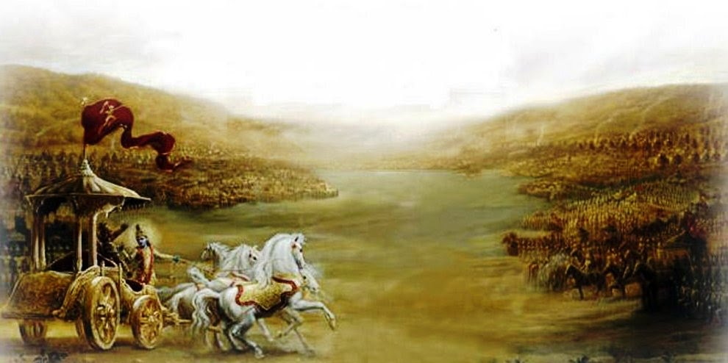
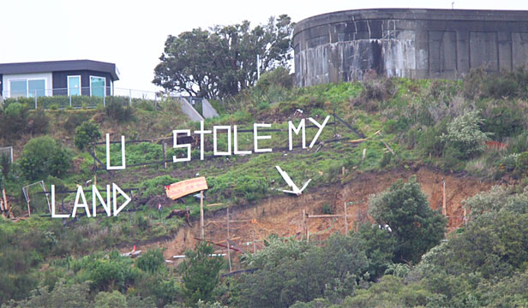
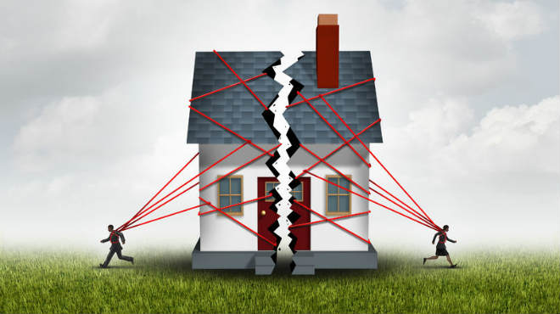
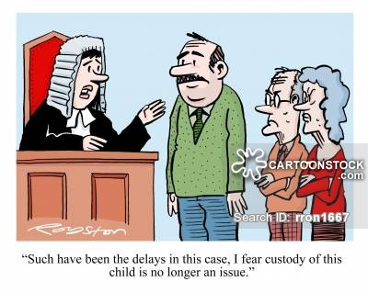
Kingdom of Dixit
Kingdom of North Sudan
Kingdom of Middle Earth

Slide 4
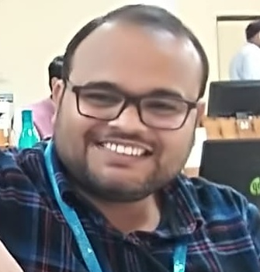






Team Profile
Srinivas Kotikila (Mr. Bitcoin) – Product Owner
Rajatha – Application Architect
Vijaya Rama Sailaesh K – Business Dev
Pavana J – Application Developer
Shashi Pendyala – Security Architect
Syeda Fathima – Application Developer
Saida Vali – Go To Market

Slide 5
Problem Statement
Property ownership in India is messy business:
Land titles are presumptive - Land records provided, in addition to other details, information on who is in possession of land, and not who the owner is
Registration of property is not mandatory for all transactions- Under the Registration Act, 1908, registration of property is not mandatory for all transactions.
The cost of registering property is high - India used to have among the highest rates of stamp duty in the world (link)
No one law by itself can determine the title to a property
Line of succession issues
Documentation includes deletions, correction fluid, or other alteration
Owner is someone other than seller shown on sales contract
Seller owned property for short time
Buyer has pre-existing financial interest in the property
Payouts to unknown parties or parties not providing real estate related services
Earnest money deposit equals the entire down payment, or is an odd amount
Buyer(s) deleted from/added to sales contract
Purchase price is substantially higher than predominant market value
Date and amount of existing encumbrances appear suspicious
Chain of title includes an interested party such as realtor or appraiser
Down payment source is other than deposits (gift, sale of personal property)
Significant or unrealistic commute distance

Slide 6
Answers to the Questionnaire (Data)
We chose this application because:
a) Interest in the area - Team is interested in future of the property market
b) Growth potential - The overall growth potential & the size of the market is extremely attractive for this team
c) Domain expertise - Team has practically faced some of the issues in transfer of property

Slide 7
Existing System
Stamp duty - 3-7%
Transfer of property act 1882
Sale deed
Release deed
Settlement deed
Will deed
Gift deed
Contract creation
Applicable after demise of owner
Section 17 of
the Registration Act, 1908. Irrevocable.
Sub registrar of Assurance office – document submission (photo, property card, etc)
Buyer
Verbal agreement
Preparation of contract
– sale document
Buyer
Court order. Irrevocable.
Transfer of property among multiple owners. Irrevocable.
Municipal authorities- revenue and land records
1
2
3
4
5
6
CHALLENGES
Registration doesn’t
mean ownership of title
Buyer responsible for validation of title of ownership
Fraud valuation during registration
Silo databases of departments
Duplicate sales deeds
Registration of property is not mandatory for all transactions

Slide 8
Statistics
Total cost of litigation is 0.5% of
$ 2Trillion GDP
66% of pending court cases
Reuters ; A World Bank study

Slide 9
Proposed Solution
A Blockchain backed property management system that brings all relevant Govt .organizations into one channel to settle property transactions and establish ownership.
All the digitized land records by the govt. are updated with coordinates (latitude and longitude) to establish accuracy of the property records.
Whenever, a transfer of ownership request is placed, the credibility of seller and buyer is verified using the Unique Identification authority .
The platform will initiate the transfer on approval of the seller to transfer the ownership to the buyer.
All relevant organizations will be able to verify the transaction & allow it to be part of the Distributed Ledger.
Once completed, it the legal documents are shared with all the parties.
Major Life Event Triggers
Unique Identification Authority
Banks and institutions
Local bodies for permission
Registration office
Regional Development authorities

Slide 10
The Model for the Future
Evolution of Blockchain backed Property Ownership
State management
of property on the
Blockchain
UI for User Interaction & Query
Smart Property Layer
Peer to Peer Token Exchange
Smart Property Layer
Tokenization of Property
Users on the platform
Apartment (Multi-storey + Multiple Owners)
Land + Structure (Multiple Owners)
Land + Structure (Single Owner)
Land (Multiple Owners + Mutation)
Land (Single Owner)
Government & Regulatory Ownership, Oversight
KYC Provider
(Aadhar)
Major Life Event Triggers
Registrar Office
Documentation, Legal & Compliance
Regional Govt Authorities
Bank & Financial Institutions

Slide 11
Key Differentiators
Core Values
Tokenization using smart features
Primary benefits
Unified distributed ledger
Improvement of Liquidity in economy
T
Reduction in cost of transfer
Secondary benefits
Eliminate litigations
RANSPARENCY
PROPER
RUST
RANSFER
Mitigate risk of fraud

Slide 12





Technologies Used

Slide 13
Application architecture
Hyperledger Fabric v.1.3
Built on AWS EC2 – T2.Large

Slide 14
Post Course
Plans after Course Completion
Add more Organizations to the Blockchain participation Channel.
Perform all validations and workflow between orgs within the app.
Add all pending Features to the app (IPFS to store registration doc & its hash to be included during block creation, Continuous lat-long to mark boundaries).
Implement other layers in the evolution diagram.
Move into asset tokenization enabling partial tokenised ownership.
Implement Peer to Peer exchange for these asset tokens.

Slide 15
Link to the App @ Google App Store
https://bit.ly/2XzlXIx

Slide 16

Demo- Execution of the application

Slide 17
Business Plan
Revenue streams:
Transaction Fee at the time of transfer (1%).
Token exchange commissions for exchanging ProperT tokens.
Platform to advertise sale of property.
Builder/Seller reputation based on the past sales.
Endorsements for Blockchain backed smart properties vs others.

Slide 18


Slide 19


Slide 20
Appendix

Slide 21
Issues
A registered sale deed is not a government guarantee of land ownership.
This implies that
Land titles in India are unclear due to various reasons such as legacy issues from the zamindari system, gaps in the legal framework, and poor administration of land records.
Agricultural land cannot be used for commercial or residential purpose
Lack of coordinates to determine the accurate province of the land owned leads to conflicts

Slide 22
History of Property ownership
Feudalism was a combination of legal and military customs in medieval Europe that flourished between the 9th and 15th centuries. Broadly defined, it was a way of structuring society around relationships derived from the holding of land in exchange for service or labour.
The Land Registration Act 1925 (LRA) was an act of Parliament in the United Kingdom that codified, prioritised and extended the system of land registration in England and Wales.^{[1]} It has largely been repealed, and updated in the Land Registration Act 2002.
Impact across valuestram: land transfer, registration, mortgage, partition, excambion, fixtures, taking of land in execution, declaration of title and apportionment.^{[4]}

Slide 23
Property acts in India
Transfer of Property Act, 1882- compulsory registration of the transfer document
Property can be transferred in several ways, and conveyance of title in India is not subject to one single piece of legislative enactment.
The transfer of immovable property must take place with the help of a written document that is properly executed by the transferor and the execution should be properly attested and registered
According to section 4 of the General Clauses Act, immovable property includes land, benefits to arise out of land and, things attached to the earth.
Immovable property includes.— (1) Land, (2) Benefits to arise out of land, and
(3) Things attached to the earth -
(i) things embedded in the earth, (ii) things attached to what is so embedded in the earth,
(iii) things rooted in the earth except.— (a) standing timber, (b) growing crops, or (c) growing grass.

